Slide 1
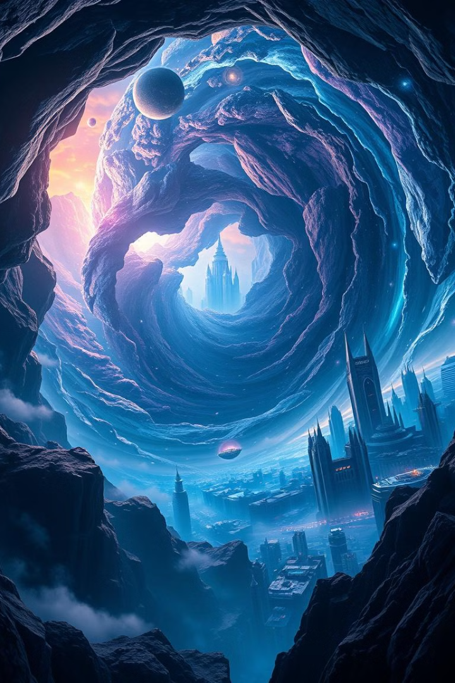
Parallel Universes: Fact or Fiction?
Exploring the possibilities of multiple realities, science and fiction, and theoretical perspectives.
by Musawarali shah

Slide 2
What if Another You Exists?
Multiple Selves?
Scientific Exploration
Consider the possibility of infinite versions of yourself.
Dive into theoretical perspectives on parallel universes.

Slide 3
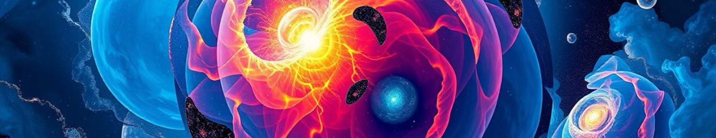



Scientific Theories of Parallel Universes
Quantum Mechanics
String Theory
Cosmic Inflation
Many-Worlds Interpretation: every quantum possibility splits.
Multiverse Hypothesis: multiple universes vibrating at different frequencies.
Bubble Universes: new universes budding off from our own.

Slide 4



Evidence and Debates
Theoretical foundations
1
Building upon existing quantum models.
Quantum physics
2
Observations suggesting alternative realities.
3
No Direct Evidence

Slide 5

Discussion & Q&A
1
Belief?
2
Proof?
Do you believe in parallel universes?
How could we prove their existence?
3
Impact?
How would life change with inter-universe travel?

